Slide 1

Execution
Toolkit
Version 12
Revised 12 Aug 2025

Slide 2
Overview
What is EWAAC?
  EWAAC Facts
  Competition vs. Fair Opportunity Exemption (FOE)
  Period of Performance
Speed of EWAAC
  Agility and Speed
  Expected DO/TO Timelines
  Actual DO/TO Timelines
  FAR Based Flexibilities
  Decentralized Ordering Explained
IDIQ User Guide
  Steps using EWAAC
  Thresholds
  Articulated Requirements
  Available Contractor Pool
  EWAAC submission POCs
  Submission Best Practices
Summary

Slide 3


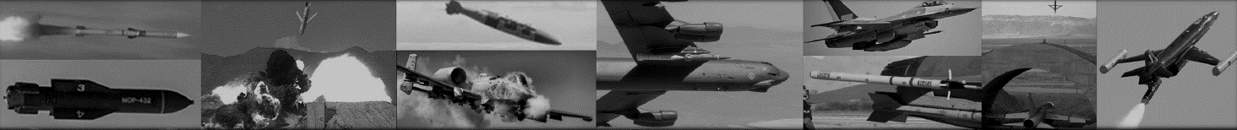
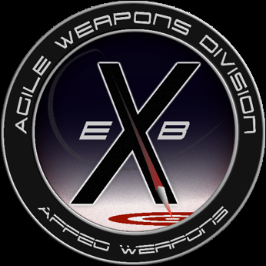
EWAAC
$46B IDIQ for Armament mission → Expires September 2031
  Eglin Armament Enterprise and DoD partners with awards that support AF Weapons Armament missions (AFNWC, AFRL, AFTC, MDA, SOCOM, and USN)
  51 requirements awarded/82 requirements in-work; $40B ceiling remaining
  No pass-through fees: Maximizes budget efficiency
  Broad Scope and Large Contractor Base
  Requirement must support Armament Mission (Open, Agile, Digital)
  Applicable to all areas and lifecycle phases of weapons development
  294 Vendors to date
EWAAC Portal
  EWAAC Portal at www.EWAACPORTAL.com
  AI-driven rapid proposal development utilizing a collaborative IL5 secured communication environment
Rapid Acquisition using FAR 16.5 Significantly reduces Award Time
  Average is 81 days for competitive proposals…fastest is 31 days
  Average is 39 days for sole source proposals…fastest is 8 days
  No funding restrictions: uses all funding types and expiring funds
  Supports urgent operational needs and quick reaction capabilities
Enterprise-Wide Agile Acquisition Contract (EWAAC)

Slide 4
EWAAC Facts
IS:
IS NOT:
Innovative contracting vehicle to support Armament related activities
Emphasizes competition and reduction of contracting lead times
Supports Urgent Operational Needs and Quick Reaction Capabilities
Funding flexible
  All colors of money
  Expiring funds
EWAAC scope is intentionally broad
  Requirements should align with EWAAC SOO
  Full lifecycle of new or existing systems
  (i.e. production and sustainment may occur)
  New technology demonstrations, prototyping, and development
  Engineering and manufacturing, testing, hardware/software mods, sustainment
  Trade space and capability studies
  Data collection and/or analysis
  Innovation hubs
A traditional program with defined scope
A pick-and choose list of contractors
For Advisory & Assistance Services (A&AS) usage (example: EPASS)
Is not for the acquisition of commercial supplies or services

Slide 5
FOPR vs FOE
FOPR:
FOE:
Fair Opportunity Proposal Request (FOPR) endeavors maximum solution trade space
Emphasizes maximum choice from a large contractor pool on each Task Order/ Delivery Order
Contractors are representative of the Armament Enterprise and uniquely vetted to innovate in a digital environment
PEO’s intent is to encourage maximum competition when applicable
Fair Opportunity Exception (FOE): Sole Source/Limited
Requires additional documentation and reviews (authority) which leads to longer lead times
Established contractor relationship (follow-on work) not a valid reason for FOE usage
Competition Encouraged!!!

Slide 6
EWAAC Period of Performance
In
EWAAC Ordering Period is 10-years
IDIQ awarded 23 Sep 2021; expected expiration 22 Sep 2031
On-ramps paused until further notice
2021
2022
2023
2024
2025
2026
2027
2028
2029
2030
2031
Phase I / 2-Year Initial
Initial Awd
Phase II / 3-Year Option
On-ramp I
Phase III / 5-Year Option
On-ramp II
On-ramp III
Final Order Execution
On-ramp IV

Slide 7
Agility and Speed
Will EWAAC be faster?
Currently established pool of 297 qualified large and small businesses
Innovative requirements planning and contracting practices
Time-to-award averages
  Traditional competitive or sole source = 330-365 days*
  Previous Agile IDIQ = 140 days
  Actual EWAAC = 65-105 days
Important steps for improving program timelines for award
  Fully developed, fine-tuned, articulated requirements documents
  Emphasize maximum competition in developing requirements
    Sole Source/Limited is possible, but EWAAC should not be used to pre-select contractors for follow-on work
    FAR 16.505(b)(2)(C) defines follow-on work as work previously awarded under the EWAAC IDIQ contract
*Source: Air Force Life Cycle Management Center (AFLCMC) Standard Process for Contract Award
Sole Source (Release of RFP to Contract Award), AFMC Contracting Mandatory Procedure, AFMC MP Part 5304- Administrative Matters, Revised Per AFMCCD 2016-07, 8 July 2015
Notes:
Will EWAAC be faster? It depends on your acquisition? Our time-savings are in the fact that you do not have to synopsis, already negotiated T&Cs, t

Slide 8
Expected DO/TO Timelines
EWAAC Delivery Order / Task Order
65-105 days from FOPR/FOE to award
Submit Scope Determination
• Via www.ewaacportal.com
Reduced award timelines depend on up-front requirements definition

Slide 9
Actual EWAAC Timelines
FOPRs: Average is 81 days for competitive proposals…fastest is 31 days​
FOEs: Average is 39 days for sole source proposals…fastest is 8 days​
Average times:
  Open Solicitation: 24.5 days
  Evaluation: 12.6 days
  Eval to Award: 23.2 days

Slide 10
IDIQ FAR Based Flexibilities
Some differences between FAR 15 and 16.5 competitive actions
 | FAR 15.3 | FAR 16.5
Decision Authority | Source Selection Authority is identified in AFFARS MP 15.3 | The Contracting Officer is the decision authority by default
Required Evaluation Factors | Cost/price and quality of product/service must be emulated (Including Past Performance and SB Participation, with some exceptions) | Cost/price must be considered under each order; no additional mandatory evaluation factors
Exchanges with Offerors | FAR 15.306 and DoD Source Selection Procedures dictate clarifications, communications, and discussions | No specific guidelines for interacting with offerors, but does allow interchanges/exchanges
Final Proposal Revisions | Must request Final Proposal Revisions if discussions are conducted | Offerors do not have to be offered an opportunity to revise their proposals through a Final Proposal Revision
Protests | All actions regardless of dollar value can be protested in accordance with FAR Part 33 | No protest is authorized under $25M, except in the areas of scope, period, or max value of the IDIQ; GAO only allowed venue
FAR 16.5 provides PCO decisive discretion authority and streamlined procedures

Slide 11
Decentralized Ordering Explained
Programs should (pre-award):
  Establish Funding
  Document requirements on SOW, SOO, or PWS
  Determine contract type and supply/service
  Establish program specific technical data rights, system architecture, etc.
  Establish proposal evaluation criteria, CDRLs, DD254s, etc.
  Follow Ordering Procedures (FAR 16.505)
Programs will (post-award):
  Program Management and contract supporting activities
  Manage kick-off meetings, PMRs, milestone events, etc. as required
  Draft/submit CPAR submissions
  Manage reviews, inspection, and acceptance of supply/service
  Manage program funding obligation and expenditures
EBX will exercise overall IDIQ contract responsibility IAW AFFARS 5316.505-90
Program Office Autonomy in Execution

Slide 12
Steps Using EWAAC
EWAAC Toolkit designed to be a guide for users to rapidly meet program requirements
Programs should (steps):
  Determine use of IDIQ based on DO/TO requirement scope fitting within the EWAAC SOO
  Complete EWAAC Scope Determination on www.ewaacportal.com
  Refine and clearly articulate requirement documents
  Establish program specific technical data rights, system architecture, etc.
  Establish funding, evaluation criteria, evaluation team, and conduct legal/policy clearance
  Issue FOPR/FOE
  Utilize FAR 16.5 procedures to the greatest extent possible
Programs will (post-award):
  Program Management and contract supporting activities
  Provide notices of award/non-award when possible
  Manage kick-off meetings, PMRs, milestone events, etc. as required
  Draft CPAR submissions to the IDIQ PM
  Manage reviews, inspection, and acceptance of supply/service
  Manage program funding obligation and expenditures
Procuring Contract Officer responsible for applicability of FAR guidelines
*FOE process may deviate from this guide; programs should independently determine FOE applicability (consult your PCO)

Slide 13
Thresholds
Thresholds to remember:
  >$2M requires Truth in Negotiations Act (TINA) cert when using FOE
  >$5M requires legal review; >$10M requires policy and business clearance
  >$10M requires Acquisition Strategy Plan (ASP) with appropriate authority if required
  >$6M allows offerors to request a formal debrief
  >$25M is protestable to General Accounting Office (GAO)
  If CAA waives contract clearance at business clearance, final legal and policy review req’d prior to award
FOE thresholds:
  <$750k PCO;
  $750k-$15M Competition Advocate;
  $15M-$100M Head of Procuring Activity;
  >$100M is the Senior Procurement Executive (SPE) and not delegable

Slide 14
FOPR Documents
FOPR Documents:
IDIQ Level Documents:
Program SOO, SOW, or PWS
*Program Section L aka ITO – Instructions, Conditions, and Notices to Offerors or Respondents
*Program Section M aka ITO – Evaluation Factors for Award
*Fair Opportunity Selection Plan
CDRLs
1279 Congressional Notification
Subcontracting Plans
DD2579 SB Coordination
EEO Compliance
*Optional/Streamlined Ordering Procedures may allow for less complex FOPR solicitation – PCO has discretion
Things to consider:
FAR 16.505(b)(1)(ii) Contracting Officers have broad discretion on streamlined ordering procedures
FAR 16.505(b)(2) Fair Opportunity Exceptions
Notes:
What are we saying with the Acq Strategy under IDIQ Level? If it is meant to say that they don’t have to conduct an Acq Strategy at the DO level then that is not accurate.

Slide 15
Articulate Requirements
Requirements best practices:
  Be clear, concise, traceable, and testable
  Be singular, product oriented, and address unique needs/ capability gaps
  Be prioritized
  Endeavor to adapt Digital, Agile, and Open elements into programs in transformative ways
  Communicate reasonable/feasible expected outcomes to industry
Things to consider:
  Stress importance of Model-Based Systems Engineering (MBSE) outcomes
  Stimulate authoritative virtualization and insist on Government owned and furnished tech stack
  Consider and exploit all Technology Readiness Level (TRL) solutions
  Foster a culture of rapid e-prototyping and small, iterative lot buys
  Encourage innovated approaches and concepts (from within and outside of DoD)
  Consider the fidelity of the requirement, and whether trade space exists within a solution
  Know your stakeholder’s requirement and utilize SME expertise
  Reference the most current GRA as a standard in program architecture design (ref. DASO)
  Utilize Digital Engineering communities to the maximum extent possible

Slide 16
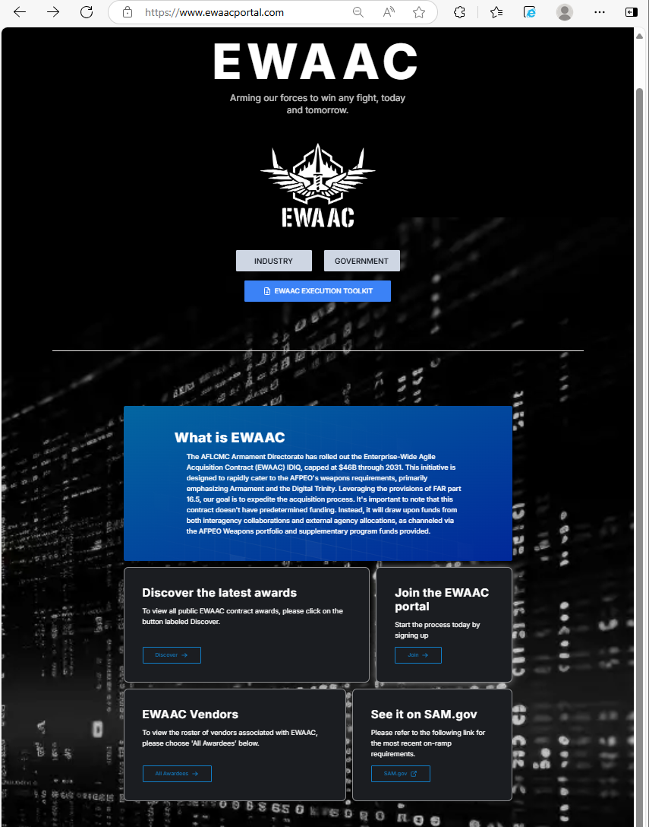
Available Contractor Pool and Latest Awards Now on Portal
Click Here

Slide 17
Submission of Documents
….
All documents created/submitted via www.ewaacportal.com
Program teams will coordinate with Legal/Policy for Business Clearance
Scope determination in 5-7 business days (sooner, if possible)
Submit additional file documentation as available, only if requested
IDIQ PMs: Maj Michael Dooley
Tim Voruz
IDIQ Contracting: Cameron White
Hillary Zelinski

Slide 18

Submission Best Practices
What has worked best:
  Organizations need to perform their own Market Research
  An ASP is required for individual requirements (>$10M) & SASS encouraged for <$10M
  Fair Opportunity Selection Plan, while not required IAW 16.5, highly encouraged
  If a contractor requests a de-brief, provide a de-brief even though it is not required IAW 16.5

Slide 19


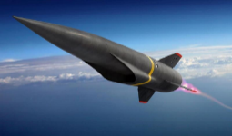
Summary
Primary focus on developing the armament enterprise, inclusive of all supporting federal entities
Expanded to 297 contractors with emphasis on digital innovation
Focused areas: Digital Acquisition and Culture (O/A/D), Armament, Enterprise Analytics, and Innovation Hub
Emphasis on competition to reduce cost, drive innovation, and eliminate vendor lock
Reduced award timelines depends on up-front requirements definition
Decentralized ordering offers program autonomy
AFPEO Weapon’s intent is EWAAC to be default contracting vehicle for Armament programs where applicable
Agile
+
=
Capability
Innovation

